Slide 1

ELECTRICITY PRICE
AND
DEMAND FORECASTING
- Vaibhav Malhotra
vaibhav.malhotra@adgitmdelhi.ac.in

Slide 2
Problem Statement
Objective:
Develop machine learning models for accurate prediction of
electricity demand and price.
Data Integration:
Integrate historical demand patterns, weather data, and other relevant
factors to enhance forecasting accuracy.
Impact:
Support smart grid operations and enable data-driven decision-making in
the energy market to optimize resource allocation and pricing strategies.

Slide 3
Content
Data Introduction
Exploratory Data Analysis (EDA) and Data Preprocessing
Feature Engineering
Model Implementation
Model Comparison
Model Selection
Conclusion

Slide 4
Data Introduction
Overview of the datasets used:
Weather Data: Contains various weather-related features such as temperature, humidity, wind speed, and weather conditions.
Energy Data: Includes features related to energy production and consumption, such as different types of generation (e.g., fossil, hydro, solar), load, and price information.
Dataset Shapes:
Weather Data: (178396, 17)
Energy Data: (35064, 29)

Slide 5
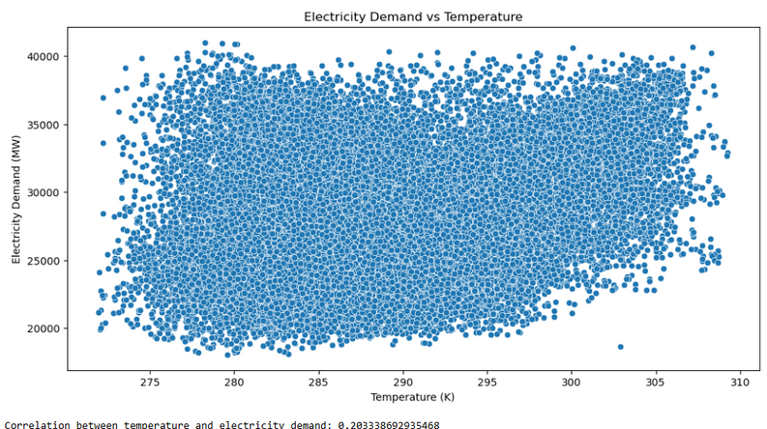
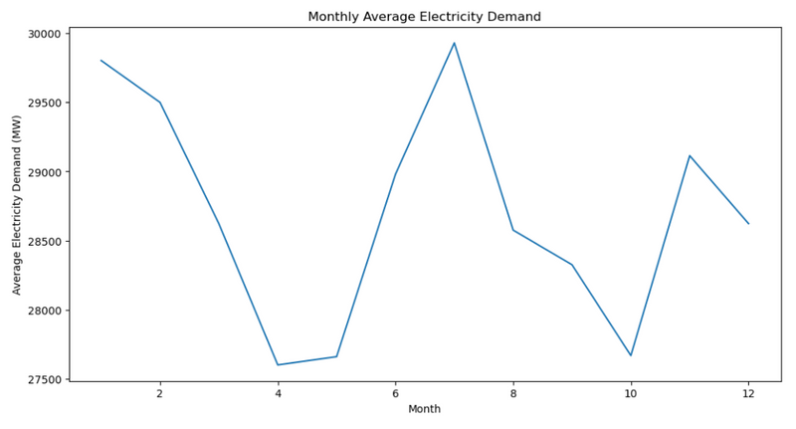
EDA and Data Preprocessing
Data preprocessing:
Removed columns with all NAN or zero value.
Handled missing values: numeric columns with mean, categorical columns with mode
Replace outliers with NaN using the IQR method.
The hypothesis is supported but with a weak correlation.
Demand peaking at times consistent with extreme temperatures.

Slide 6
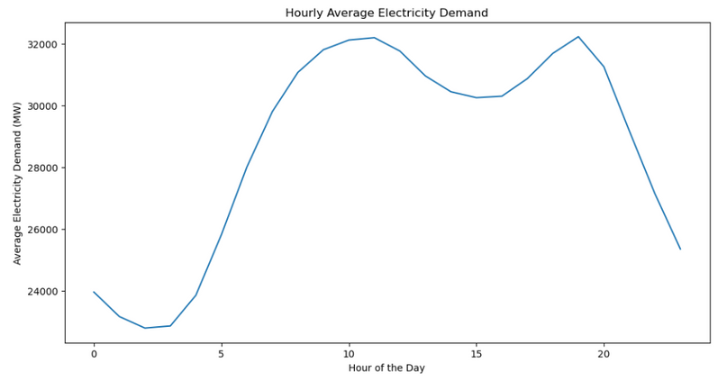
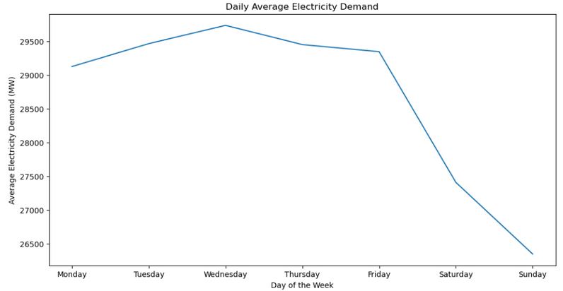
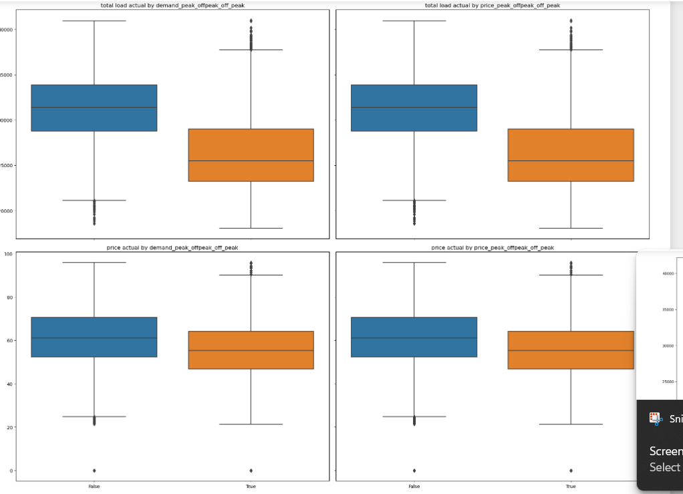
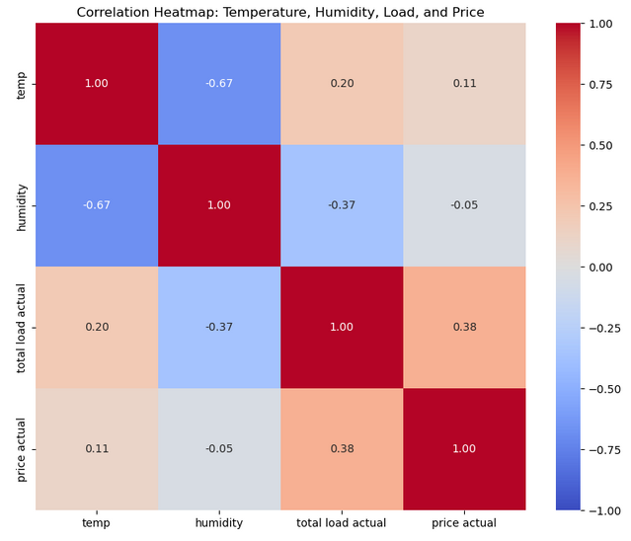
Distinct peaks and troughs corresponding to different hours of the day.
Electricity demand patterns differ between weekdays and weekends.
1 had a higher median score, while 2 showed greater variability in exam scores.

Slide 7
Feature Engineering
Temporal Features:
Hour of Day
Categorical Features:
Peak/Off-Peak Classification
Day of Week and Weekend Classification:
One-Hot Encoding
Month and Seasonal Variation:
One-Hot Encoding
Temperature Features:
Squared and Cubed Temperatures

Slide 8
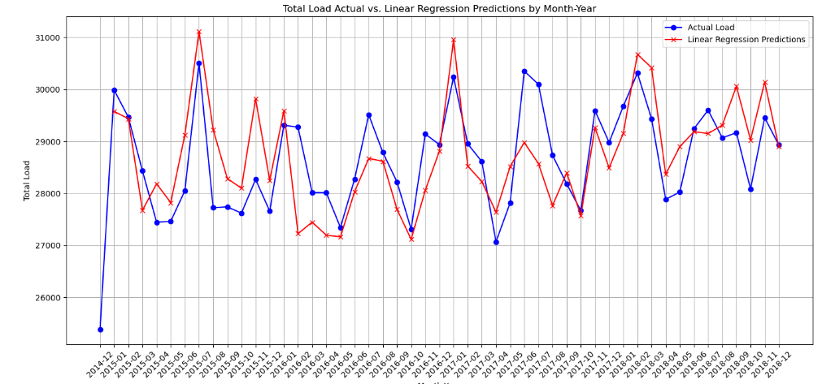
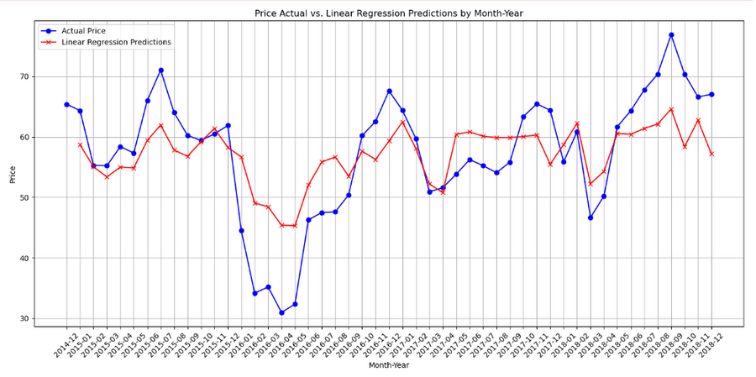
Model Implementation
Linear Regression
MAE: 1693.6033
RMSE: 2250.50341
MAPE: 5.9981%
R²: 0.7555
Adjusted R²: 0.7540
MAE: 9.1610
RMSE: 12.6693
MAPE: 15.4059%
R²: 0.3325
Adjusted R²: 0.3286

Slide 9
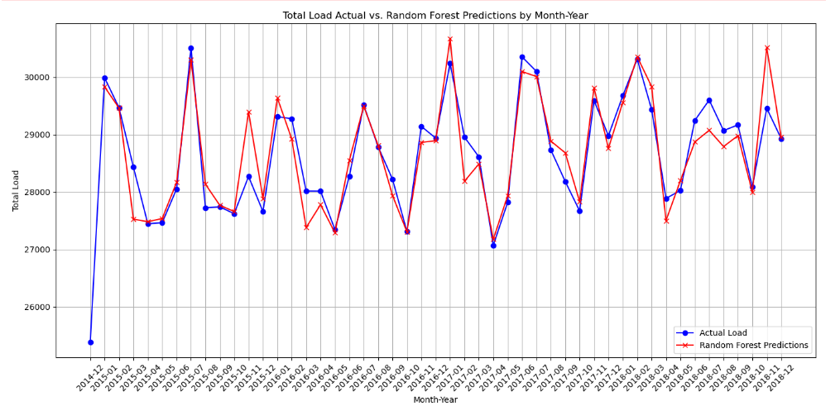
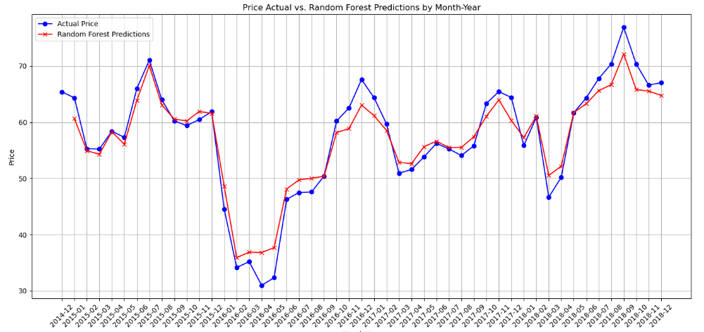
Random Forest
MAE: 826.4561
RMSE: 1107.4328
MAPE: 2.9379%
R²: 0.9407
Adjusted R²: 0.9404
MAE: 4.3753
RMSE: 7.1094
MAPE: 7.3093%
R²: 0.7898
Adjusted R²: 0.7886

Slide 10
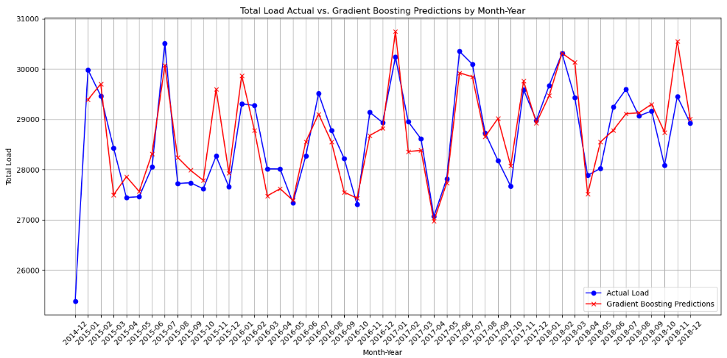
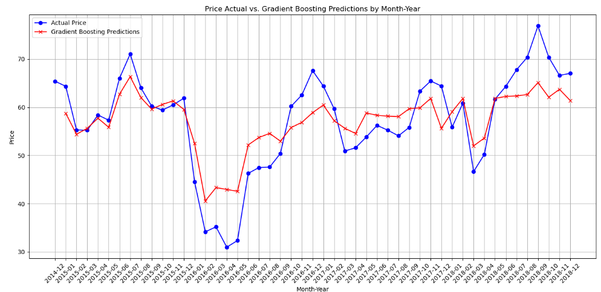
Gradient Boosting
MAE: 1163.9760
RMSE: 1477.2702
MAPE: 4.1681%
R²: 0.8946
Adjusted R²: 0.8940
MAE: 7.4226
RMSE: 10.5024
MAPE: 12.5529%
R²: 0.5413
Adjusted R²: 0.5387

Slide 11
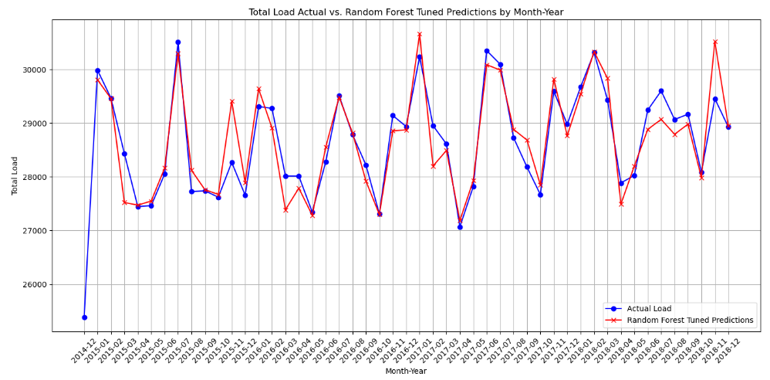
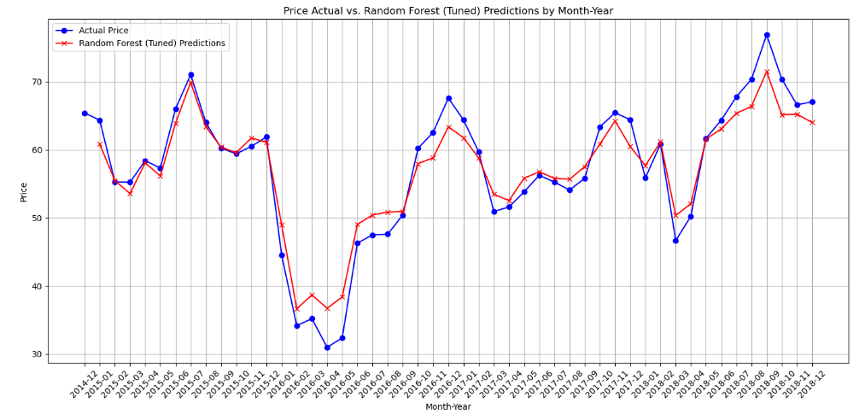
Random Forest (Tuned)
MAE: 835.7118
RMSE: 1115.1523
MAPE: 2.9702%
R²: 0.9400
Adjusted R²: 0.9396
MAE: 4.2886
RMSE: 6.9711
MAPE: 7.1015%
R²: 0.7979
Adjusted R²: 0.7968

Slide 12
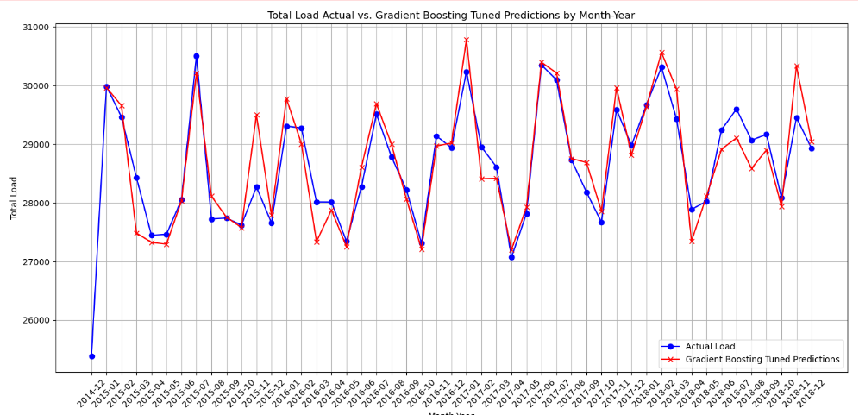
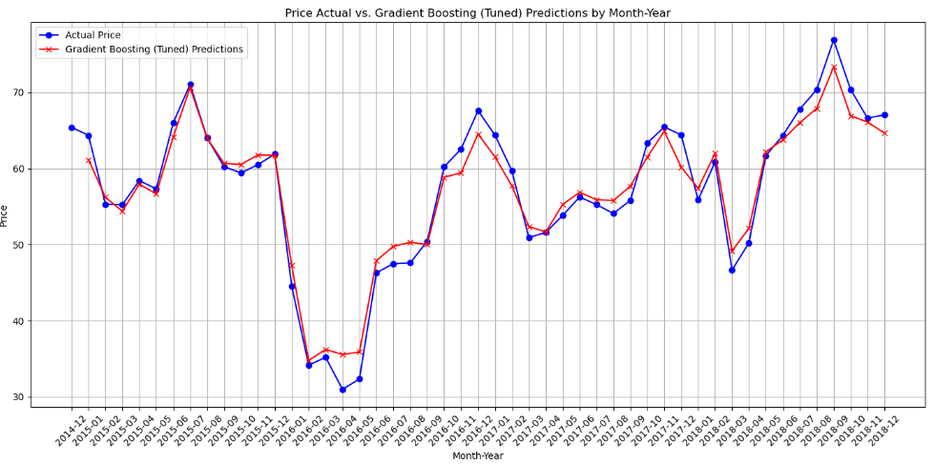
Gradient Boosting (Tuned)
MAE: 739.2993
RMSE: 975.0947
MAPE: 2.6289%
R²: 0.9541
Adjusted R²: 0.9538
MAE: 4.8166
RMSE: 7.3686
MAPE: 8.2530%
R²: 0.7742
Adjusted R²: 0.7729

Slide 13
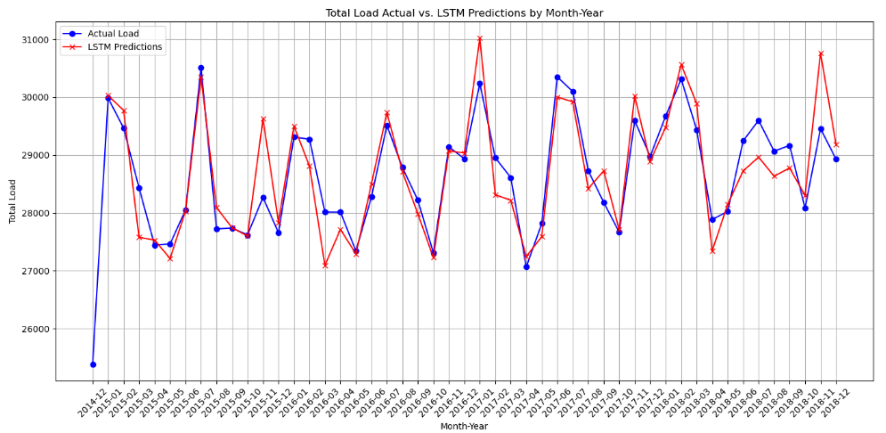
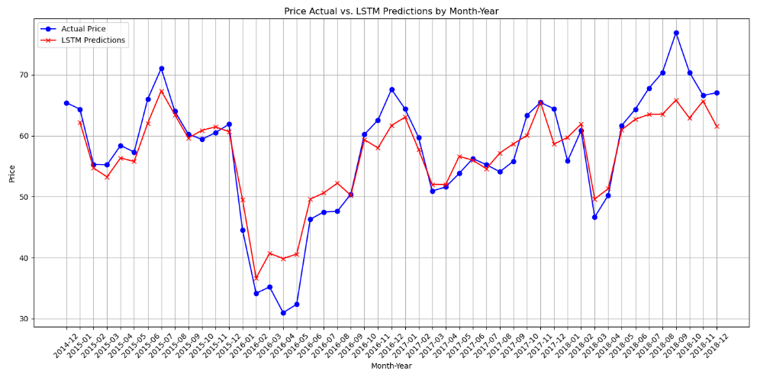
LSTM
MAE: 857.4957
RMSE: 1127.5320
MAPE: 3.0512%
R²: 0.9386
Adjusted R²: 0.9383
MAE: 6.6625
RMSE: 9.4803
MAPE: 11.5711%
R²: 0.6262
Adjusted R²: 0.6241

Slide 14
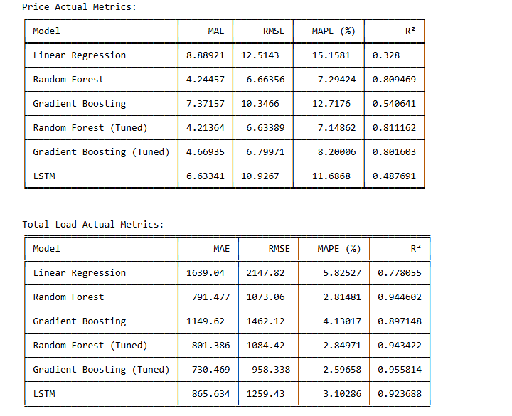
Model Comparison
For Price actual: Random Forest (Tuned)
For Load actual: Gradient Boosting(Tuned)

Slide 15
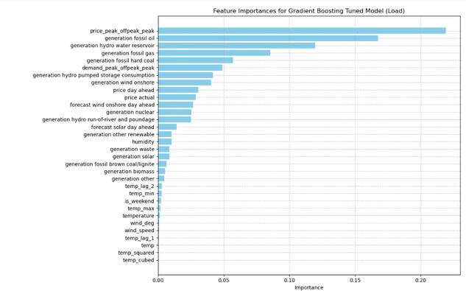
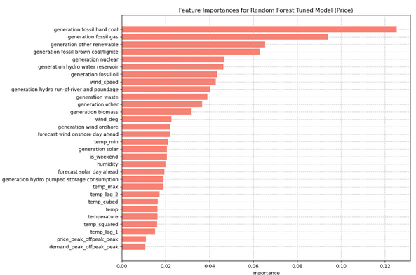
Model Selection
For Load actual: Gradient Boosting(Tuned) model performed well with good R^2 and MAPE value.
For Price actual: Random Forest (Tuned) model performed well with good R^2 and MAPE value.

Slide 16
Conclusion
Model Selection and Tuning:
Random Forest (tuned for price) and Gradient Boosting (tuned for load) outperformed other models.
Least MAPE% and better R² and adjusted R² values influenced our choice.
Data-Driven Insights:
Uncovered relationships between demand, price, and influencing factors.
These insights inform long-term energy planning.
Scalable Solutions:
Consider scalability as data volumes grow.

